Slide 1
Lesson 7 Single-Cycle Timed Loops
Dataflow in FPGA
Single-Cycle Timed Loop
FPGA Clocks
SCTL Errors

Slide 2
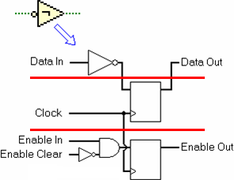
A. Dataflow in FPGA
Three components necessary to maintain data flow:
The corresponding logic function
Synchronization
The enable chain
Notes:
<EPS SOURCE>
How LabVIEW is Transformed for FPGA
LabVIEW executes code in a dataflow manner. A node executes when data is present on all the inputs for the node. When the node finishes execution, the outputs of the node pass data to the next node downstream. LabVIEW FPGA uses three components to maintain this dataflow paradigm. First, the node has logic corresponding to its function. In the figure above, notice the Boolean Not function and its associated logic. The next component needed for dataflow is synchronization. This component registers the outputs of the function in order to isolate the logic from timing uncertainties. Finally additional logic referred to as the enable chain coordinates the dataflow by validating the inputs and outputs.
Register (flip-flop) passes data from the input to the output on the rising edge of the clock.

Slide 3

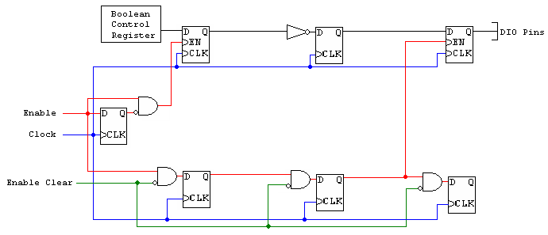
Dataflow in FPGA
Notes:
Enforcing Dataflow in FPGA
The figure above shows a simple VI that has a Boolean control, a Not function and a Digital Output function.
The Boolean control has some logic associated with the data register to retrieve data from a host application. A flip-flop links the enable chain.
The Not function has the logic associated with the function itself, a synchronization flip-flop, and a enable chain flip-flop.
The Digital Output function has a synchronization flip-flop and an enable chain flip-flop.
When the program runs, the enable line goes high to enable the synchronization flip-flop associated with the Boolean control. Meanwhile, a rising edge of the clock pushes the data from the register through the flip-flop. Downstream, the previous values are held on the outputs of the flip-flops.
During the next rising edge of the clock, the synchronization flip-flop associated with the Not function passes the new value through. On the third rising edge of the clock, the enable in of the digital output is high and the new value is pushed through the flip-flop to the I/O pins.
The data is synchronized using a flip-flop that pushes the data through the flip-flop on the first rising edge of the clock.

Slide 4
Dataflow in FPGA
Each function or VI takes a minimum of 1 clock cycle
Functions can run in parallel
Some dependent functions must run in sequence
Application can only run as quickly as the sum of items in a sequence
While Loops have a 2 clock cycle overhead
Notes:
LabVIEW executes code in a dataflow manner. Nodes execute when data is present on all inputs. When the node finishes execution the outputs of the node pass data to the next node downstream. The previous figure shows an example of the FPGA hardware required to implement a Boolean operation.
LabVIEW code is transformed into FPGA logic in three sections—logic, synchronization, and the enable chain. The logic, shown in the upper third of the figure, corresponds to the actual LabVIEW operation. In this example, the LabVIEW code is a Not function corresponding to an inverter in the FPGA hardware. The synchronization register shown in the middle of the figure guarantees that data is output only on rising edges of the clock. The final portion of FPGA code that is generated from the LabVIEW code is the enable chain. The enable chain is an additional register that only outputs on the rising edge of the clock. The enable chain guarantees that the FPGA logic executes in the same order depicted on the block diagram.
Due to the enable chain overhead, each function or VI takes a minimum of one clock cycle. Some functions, such as analog input operations, can take hundreds of clock cycles depending upon the complexity of the operation and hardware limitations.
A VI can run only as fast as the sum of the items in a combinatorial path. One advantage of using an FPGA is that code can run in true parallel to another operation. Because you can create code in parallel, it is often best to design code so that as many parallel operations can take place as possible. This uses the same amount of FPGA space, and can increase the execution speed by reducing the combinatorial path size.

Slide 5
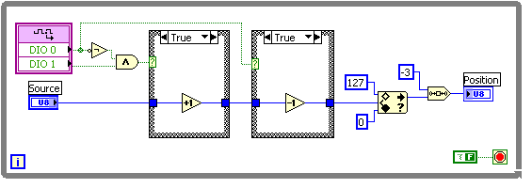
Execution of a While Loop
Use a single-cycle Timed Loop to convert this 12 clock-cycle While Loop
1
2
3
4
5
6
7
8
9
10
11
12
Notes:
<NO NAME>

Slide 6
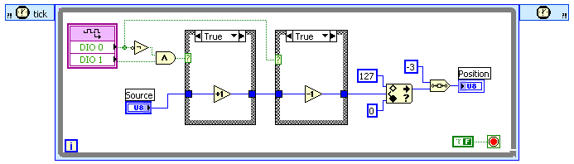
Execution of a Single-Cycle Timed Loop
1
Into this 1 clock-cycle Single Cycle Timed Loop
Notes:
<NO NAME>
Single-Cycle Timed Loop (SCTL)
An SCTL is a Timed Loop that has been placed onto the block diagram of an FPGA VI. The structure name is the same as the Timed Loop structure as used in Real-Time and in Windows. However, the Timed Loop on the FPGA block diagram executes one iteration per clock cycle.

Slide 7
B. Single-Cycle Timed Loop
LabVIEW automatically optimizes code inside an SCTL
Removes enable chain registers from code inside the SCTL
Executes more quickly
Consumes less space on the FPGA
All code in the SCTL finishes executing within one tick of the specified FPGA clock

Slide 8
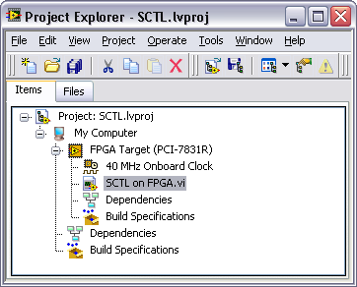
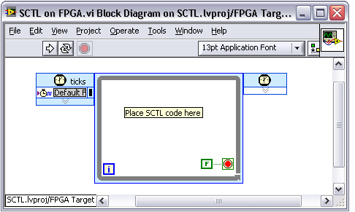
B. Single-Cycle Timed Loop
Single-cycle Timed Loop
Create by placing a Timed Loop on the block diagram of an FPGA target VI

Slide 9
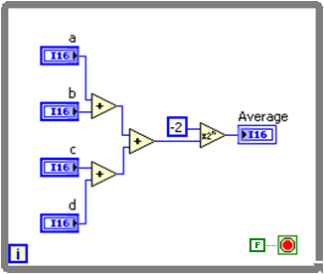
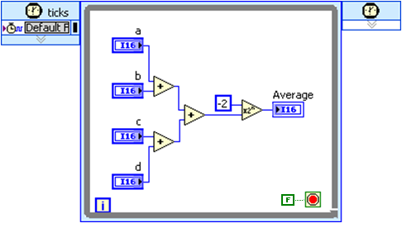
B. Single-Cycle Timed Loop
Saved 6 ticks by placing this code in a SCTL
7 Ticks
1 Tick
Notes:
SCTL Example
The figure above shows example using the SCTL to perform some data processing within one clock cycle. The same operation in a While Loop would require about 6 clock cycles including the overhead of the While Loop. The SCTL also removes the enable chain overhead and therefore uses few FPGA slices. As shown, the SCTL uses 5% fewer slices than the code outside the SCTL.

Slide 10
Timed Loop Behavior Based On Target
FPGA Target
Executes as a single-cycle Timed Loop
Use to optimize performance, such as resource utilization and throughput, or to simply meet the performance requirements of your application
RT Target or Windows/My Computer Target
Executes as a Timed Loop
Implement multirate timing capabilities, precise timing, feedback on loop execution, timing characteristics that change dynamically, or several levels of execution priority
Use to separate deterministic from non-deterministic tasks
This is covered in the LabVIEW Real-Time Application Development course
Notes:
See Timed Loop VI Help for info on differences in FPGA and RT and Windows.

Slide 11
Exercise 7-1: While Loop versus Single-Cycle Timed Loop
Improve loop execution speeds using a single-cycle Timed Loop.
Notes:
Prep discussion:
In this exercise, the student will improve loop execution speeds by using a single-cycle Timed Loop. The student will examine a pre-built VI that contains benchmarking code. The student will add a single-cycle Timed Loop to the VI and examine the results of the benchmarking code comparing the execution speeds of code in a While Loop and code in a SCTL.

Slide 12
Exercise 7-1: While Loop versus Single-Cycle Timed Loop
Why does the code require more ticks in a While Loop than in a single-cycle Timed Loop?
What is the purpose of the Decrement function the right of each Sequence structure?
Notes:
LabVIEW automatically optimizes code inside a SCTL by removing the enable chain registers from code inside the SCTL. Therefore, code inside a SCTL executes more quickly. All code in a SCTL finishes executing within one tick of the specified FPGA clock.
The decrement function subtracts one from the result of the calculation to compensate for the execution time of the benchmarking code.

Slide 13
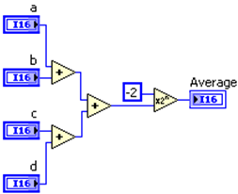
C. Using FPGA Clocks
This FPGA code always requires 5 clock ticks
Time of clock tick = 1 / clock frequency
The default FPGA clock frequency depends on the hardware. For example, clock frequency is 40 MHz for R Series boards and cRIO
Altering clock frequencies alters the execution speed of FPGA code

Slide 14
C. Using FPGA Clocks
FPGA Clocks
Determine the execution time of the individual VIs and functions on the FPGA VI block diagram
Types of FPGA Clocks
Base Clock and Derived Clock
Top-level Clock
Notes:
Info from LV Help»FPGA Module»Using FPGA Clocks and Timing»Changing the Top-Level FPGA Target Clock Rate.

Slide 15
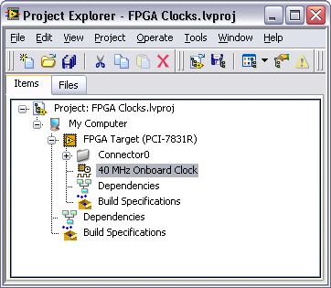
Using FPGA Clocks – Base Clock
FPGA Base Clock
Digital signal existing in hardware that you can use as a clock for an FPGA application
FPGA targets have an onboard clock
Notes:
Info from LV Help»FPGA Module»Using FPGA Clocks and Timing.

Slide 16
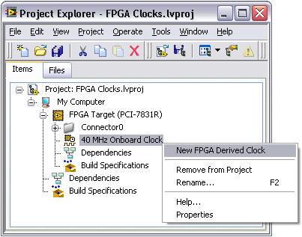
Using FPGA Clocks – Derived Clock
FPGA Derived Clock
Created from a base clock
Can derive clock frequencies other than the base clock frequency
Can use derived clocks as a clock for an FPGA application
Notes:
Info from LV Help»FPGA Module»Using FPGA Clocks and Timing

Slide 17
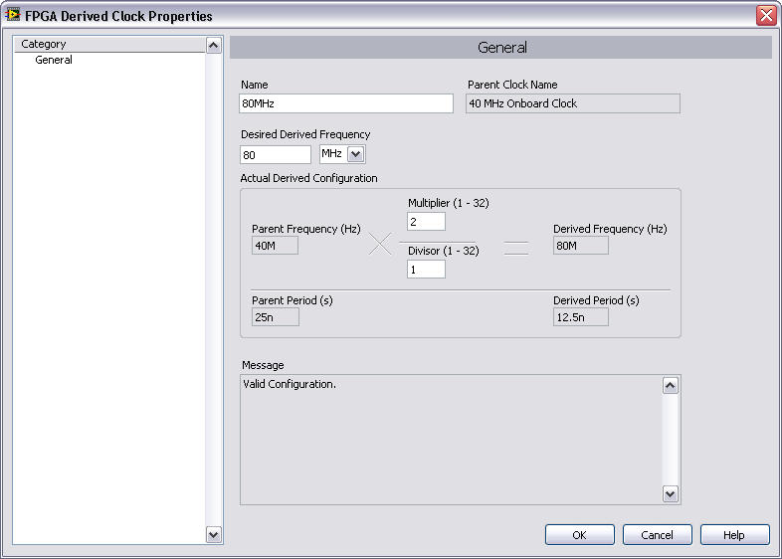
Derived Clock Configuration

Slide 18
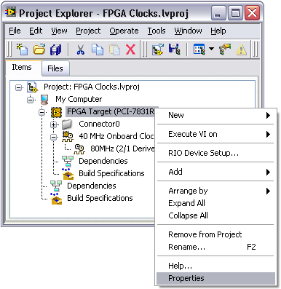
Using FPGA Clocks – Top-level Clock
FPGA Top-level Clock
Clock that the FPGA VI uses outside of SCTLs
Controls the execution rate of the code outside of SCTLs
Default top-level clock is the onboard FPGA clock
Notes:
Info from LV Help»FPGA Module»Creating FPGA VIs» Using FPGA Clocks and Timing»Controlling the FPGA VI Execution Rate.

Slide 19
Using FPGA Clocks – Top-level Clock
Changing the FPGA Top-level Clock Rate
Most LabVIEW FPGA functions are designed to compile successfully at clock rates of 40 MHz
Not all FPGA VIs successfully compile with faster clock rates
Compilation Status window will report a failure if the clock rate is too fast for the FPGA VI
Notes:
Info from LV Help»FPGA Module»Creating FPGA VIs»Changing the Top-Level FPGA Target Clock Rate.
LV Help»FPGA Module»Creating FPGA VIs»Understanding Timing Considerations for FPGA Vis.

Slide 20
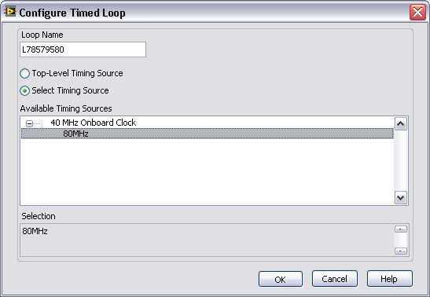
Using FPGA Clocks with SCTL
Can configure a SCTL to use a specific FPGA clock as its timing source
Default timing source is the top-level clock
Can set a different base clock or derived clock as the timing source
Notes:
Info from LV Help»FPGA Module»Using FPGA Clocks and Timing»Selecting an FPGA Clock as the Timing Source for a SCTL.

Slide 21
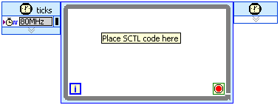
Using FPGA Clocks with SCTL
All code in the SCTL must finish executing within one cycle of the selected timing source for the FPGA VI to compile successfully
FPGA compilation fails with a timing violation report when the code in the SCTL takes more than the specified time
SCTL code must finish executing within one cycle of the 80 MHz derived clock
Notes:
Info from LV Help»FPGA Module»Using FPGA Clocks and Timing»Selecting an FPGA Clock as the Timing Source for a SCTL.

Slide 22
FPGA Clock Summary
Base Clock
Digital signal existing in hardware that you can use as a clock for an FPGA application
Derived Clock
Created from a base clock that you can use as additional clocks for an FPGA application
Top-level Clock
Clock that the FPGA VI uses outside of SCTLs

Slide 23
D. SCTL Errors – Unsupported Objects
SCTL contents execute in a single clock period
Some VIs and functions cannot be used in the loop at all
Analog input, analog output (Most HW)
Nested loops (While Loop, For Loop, Timed Loop)
Loop Timer and Wait Express VIs
Objects requiring more than one clock cycle to execute
Divide function
Quotient & Remainder function
See the LabVIEW FPGA Help for a detailed list of unsupported objects
Notes:
You can use most VIs and functions available when you target an FPGA target in a single-cycle Timed Loop. However, you cannot use the following VIs, functions, and structures in a single-cycle Timed Loop. LabVIEW reports a code generation or compile-time error for the single-cycle Timed Loop when you try to compile an FPGA VI with any of the following VIs, functions, or structures in a single-cycle Timed Loop.
FIFO Clear function
For Loop
FPGA Math & Analysis VIs except the Linear Interpolation, Look-Up Table 1D, and Saturation Arithmetic VIs
FPGA I/O Method Node except with some FPGA targets
FPGA I/O Property Node except with some FPGA targets
Interrupt VI
Loop Timer VI
Multiple FPGA I/O Nodes configured for the same I/O resource if at least one node is inside the loop and at least one node is outside the loop
Non-reentrant subVIs if you use multiple instances
Quotient & Remainder function
Rotate 1D Array function
Timed Loop
Wait Express VI
Wait on Occurrence function
While Loop

Slide 24
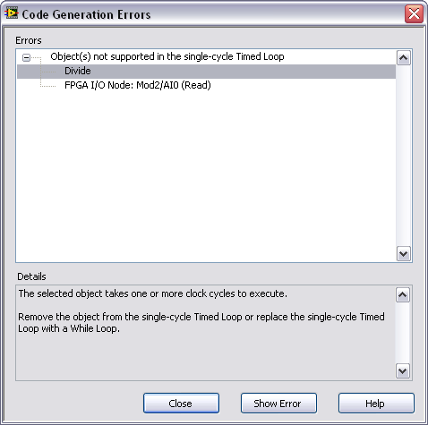
SCTL Errors – Unsupported Objects
Code Generation Errors window shows unsupported objects
Appears if errors occur while generating intermediate files
Xilinx compilation process does not occur

Slide 25
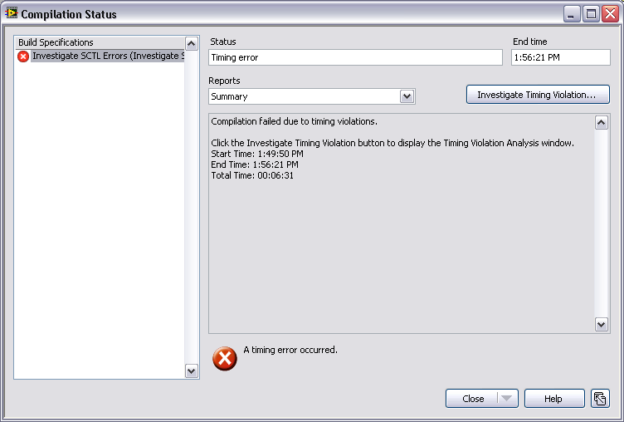
SCTL Errors – Combinatorial Paths
SCTL limited by logic and routing delays in FPGA circuitry
If total path propagation takes longer than 1 clock cycle, compilation fails
No way to pre-determine path length
Try to reduce path length before using SCTL
Notes:
A combinatorial path is the path through logic between the output of a register and the input of another register on an FPGA. A register stores data on an FPGA and updates the data on the rising edge of a clock. Long combinatorial paths take more time to execute and limit the maximum clock rate of the clock domain.
Long combinatorial paths are typically a problem in single-cycle Timed Loops because the logic between the input register and the output register must execute within one period of the clock rate you specify. In the single-cycle Timed Loop, registers within and between components are removed, increasing the length of the combinatorial path between registers. If the code in a combinatorial path does not execute within a clock cycle, LabVIEW returns a timing violation in the Compilation Failure dialog box.
Note Deeply nested Case structures also can cause LabVIEW to return a timing violation in the Compilation Failure dialog box.
To reduce the length of a combinatorial path, first simplify the logic as much as possible. Once you have reduced the logic to its simplest form, you can further reduce the length of a combinatorial path by dividing the logic into discrete steps and pipelining your design.

Slide 26
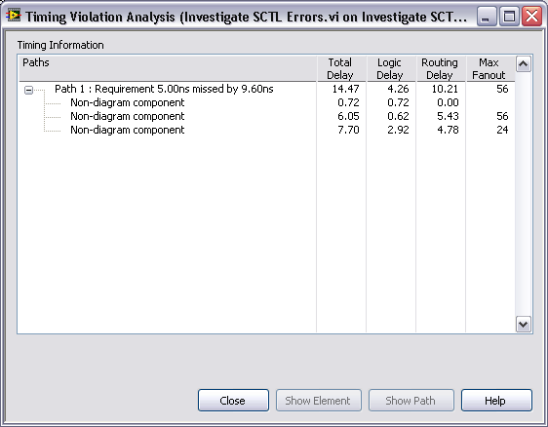
SCTL Errors – Combinatorial Paths
Investigate timing violations with Timing Violation Analysis window
See logic, routing, and total delay of each item
Show path of timing violation on the block diagram
Notes:
A combinatorial path is the path through logic between the output of a register and the input of another register on an FPGA. A register stores data on an FPGA and updates the data on the rising edge of a clock. Long combinatorial paths take more time to execute and limit the maximum clock rate of the clock domain.
Long combinatorial paths are typically a problem in single-cycle Timed Loops because the logic between the input register and the output register must execute within one period of the clock rate you specify. In the single-cycle Timed Loop, registers within and between components are removed, increasing the length of the combinatorial path between registers. If the code in a combinatorial path does not execute within a clock cycle, LabVIEW returns a timing violation in the Compilation Failure dialog box.
Note Deeply nested Case structures also can cause LabVIEW to return a timing violation in the Compilation Failure dialog box.
To reduce the length of a combinatorial path, first simplify the logic as much as possible. Once you have reduced the logic to its simplest form, you can further reduce the length of a combinatorial path by dividing the logic into discrete steps and pipelining your design.

Slide 27
SCTL Errors – Combinatorial Paths
Timing Violation Analysis window
Fix the timing violations
Speed up path by optimizing the code in the SCTL
Select a slower clock for the SCTL timing source
Speed up path by moving some code out of the SCTL
Notes:
A combinatorial path is the path through logic between the output of a register and the input of another register on an FPGA. A register stores data on an FPGA and updates the data on the rising edge of a clock. Long combinatorial paths take more time to execute and limit the maximum clock rate of the clock domain.
Long combinatorial paths are typically a problem in single-cycle Timed Loops because the logic between the input register and the output register must execute within one period of the clock rate you specify. In the single-cycle Timed Loop, registers within and between components are removed, increasing the length of the combinatorial path between registers. If the code in a combinatorial path does not execute within a clock cycle, LabVIEW returns a timing violation in the Compilation Failure dialog box.
Note Deeply nested Case structures also can cause LabVIEW to return a timing violation in the Compilation Failure dialog box.
To reduce the length of a combinatorial path, first simplify the logic as much as possible. Once you have reduced the logic to its simplest form, you can further reduce the length of a combinatorial path by dividing the logic into discrete steps and pipelining your design.

Slide 28
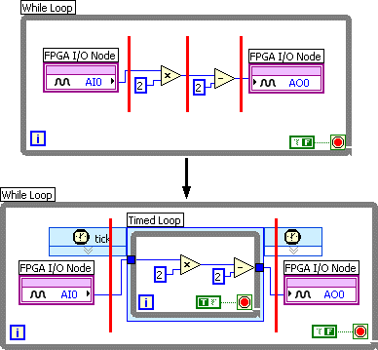
E. Optimizing Code within a While Loop
Use SCTL within a While Loop to optimize sections of code
Place section of code to optimize inside a SCTL
Wire a True constant to the SCTL conditional terminal
Place objects unsupported outside of the SCTL
Notes:
Screenshot is from LV Help»Creating FPGA VIs»Optimizing FPGA VIs for Speed and Size»Using Single-Cycle Timed Loops to Optimize FPGA VIs.
You also can include logic in a single-cycle Timed Loop to optimize code in an FPGA VI, as shown in the following block diagram. If you use a single-cycle Timed Loop within a While Loop, as shown, wire a True constant to the condition terminal so that the code within the Timed Loop executes only once.
If you want to use the single-cycle Timed Loop, all operations inside the loop must fit within one cycle of the FPGA clock. You can use most VIs and functions in a single-cycle Timed Loop. However, LabVIEW reports a code generation or compile-time error for the single-cycle Timed Loop when you compile an FPGA VI with certain VIs, functions, or structures in a single-cycle Timed Loop. Refer to Timed Loop for more information about objects you cannot use in a single-cycle Timed Loop.

Slide 29
Exercise 7-2: Fixing SCTL Errors
Examine and fix errors in a single-cycle Timed Loop caused by unsupported objects and clock rates.
Notes:
Prep discussion:
In this exercise, the student inherits an FPGA VI that contains code in a single-cycle Timed Loop. When the student tries to compile the VI in this exercise, the student run into errors caused by unsupported objects and clock rates. The student will use the Code Generation, Compilation Status, and Timing Violation Analysis windows to examine and fix the errors.

Slide 30
Exercise 7-2: Fixing SCTL Errors
Why is the NI 9233 Analog Input FPGA I/O Node not supported in a single-cycle Timed Loop?
How can you estimate the fastest derived clock rate with which the SCTL will successfully compile?
Notes:
Code in a SCTL must finish executing within one clock cycle, and analog input typically takes longer than one clock cycle to execute.
Recall that the Timing Violation Analysis window shows the total time required by each path. The inverse of the total time will give you an estimate of the fastest clock rate that will still allow enough time for the code in the path to finish executing.
Instructor can go to the whiteboard and demonstrate this calculation. In this exercise, the path required approximately 8.29ns. The inverse (1/x) of 8.29ns is approximately 120 MHz. The fastest, successful derived clock rate for this SCTL should be around 120 MHz.

Slide 31
Summary—Matching Quiz
FPGA base clock
FPGA derived clock
FPGA top-level clock
Clock that an FPGA VI uses outside of SCTLs
Clock created from a base clock that you can use as additional clocks for an FPGA application
Digital signal existing in hardware that you can use as a clock for an FPGA application

Slide 32
Summary—Matching Quiz Answers
FPGA base clock
FPGA derived clock
FPGA top-level clock
Clock that an FPGA VI uses outside of SCTLs
Clock created from a base clock that you can use as additional clocks for an FPGA application
Digital signal existing in hardware that you can use as a clock for an FPGA application

Slide 33
Summary—Quiz
How does the single-cycle Timed Loop create a smaller FPGA footprint and execute within one clock tick?
By using other VIs logic functions when they are not in use
By eliminating the enable chain overhead
By passing the data to the real-time controller to process
By skipping some functions and having incomplete functionality
Notes:
Answer is a.

Slide 34
Summary—Quiz Answer
How does the single-cycle Timed Loop create a smaller FPGA footprint and execute within one clock tick?
By using other VIs logic functions when they are not in use
By eliminating the enable chain overhead
By passing the data to the real-time controller to process
By skipping some functions and having incomplete functionality
Notes:
Answer is b.

Slide 35
Summary—Quiz
Which of the following objects are NOT supported in single-cycle Timed Loops?
Add
For Loop
Loop Timer VI
NI 9211 Analog Input FPGA I/O Node

Slide 36
Summary—Quiz Answers
Which of the following objects are NOT supported in single-cycle Timed Loops?
Add
For Loop
Loop Timer VI
NI 9211 Analog Input FPGA I/O Node
Notes:
Answer is b, c, d.

Slide 37
Summary—Quiz
If the code in your SCTL causes a timing violation, which of the following methods can help fix it?
Optimize the code in the SCTL
Move some code out of the SCTL
Select a faster clock for the SCTL timing source
Select a slower clock for the SCTL timing source

Slide 38
Summary—Quiz Answers
If the code in your SCTL causes a timing violation, which of the following methods can help fix it?
Optimize the code in the SCTL
Move some code out of the SCTL
Select a faster clock for the SCTL timing source
Select a slower clock for the SCTL timing source
Notes:
Answer is a, b, d.

